Slide 1


Workout Gnerator
2025
HIGH
INTENSITY
Created By: Marcell Frost

Slide 2
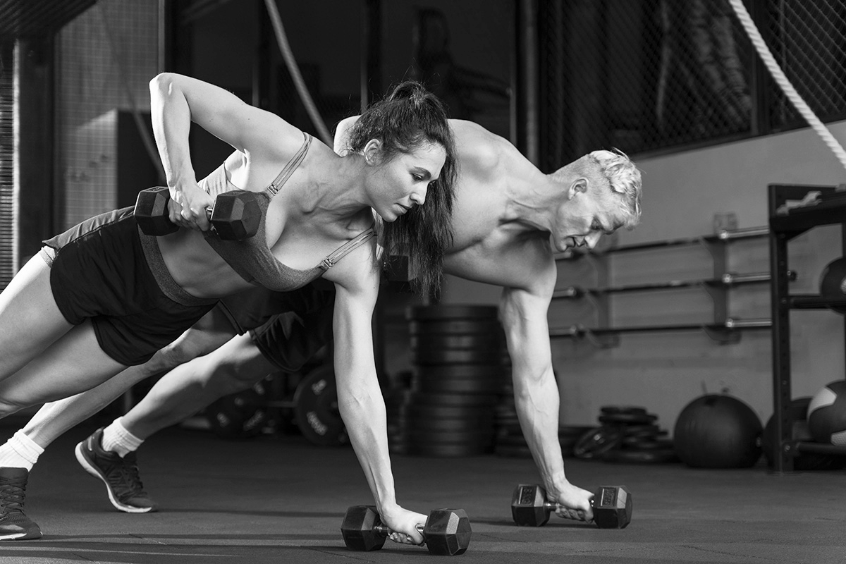
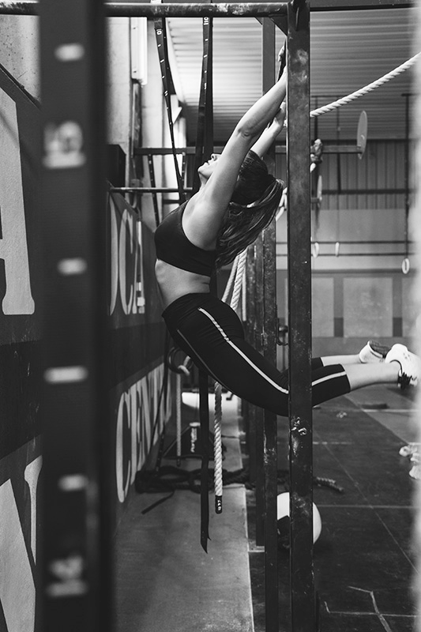
INTRODUCTION
This Workout Generator is designed to create a personalized workout routine specifically catered to the users experience level, available time and equipment access. Whether you're just starting your fitness journey or you're a seasoned gym-goer, this generator removes the guesswork and delivers efficient, easy to follow workout plans.
TRAINING

Slide 3
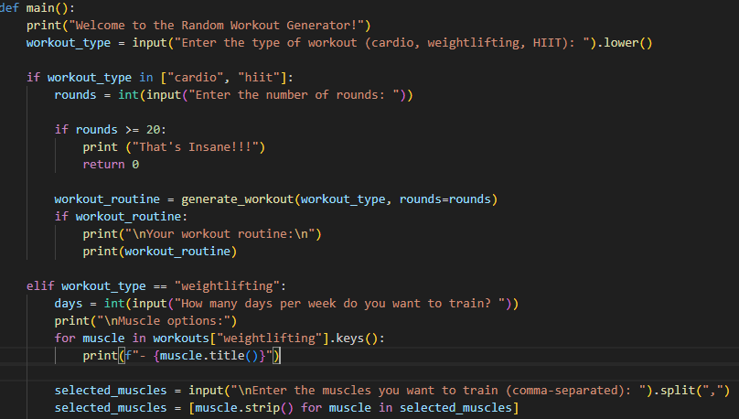
A DEEPER LOOK
MF WORKOUTGENERATOR

Slide 4
CONTENTS OF THIS TEMPLATE
GYM
This is a slide structure based on a school center presentation
You can delete this slide when you’re done editing the presentation
Fonts | To view this template correctly in PowerPoint, download and install the fonts we used
Used and alternative resources | An assortment of graphic resources that are suitable for use in this presentation
Thanks slide | You must keep it so that proper credits for our design are given
Colors | All the colors used in this presentation
Infographic resources | These can be used in the template, and their size and color can be edited
Customizable icons | They are sorted by theme so you can use them in all kinds of presentations
For more info: SLIDESGO | SLIDESGO SCHOOL | FAQS
You can visit our sister projects: FREEPIK | FLATICON | STORYSET | WEPIK | VIDFY

Slide 5
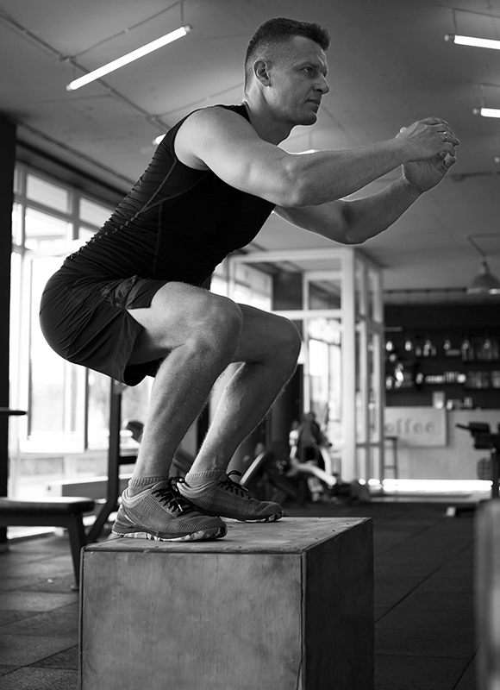
TIME TO MOVE!
01
02
03
04
01
02
OUR METHOD
OUR CLASSES
You can describe the topic of the section here
You can describe the topic of the section here
03
04
ENROLLMENT
OUR TRAINERS
You can describe the topic of the section here
You can describe the topic of the section here
2022

Slide 6

01
TEACHING METHOD
2025
01
You can enter a subtitle here if you need it

